Slide 1



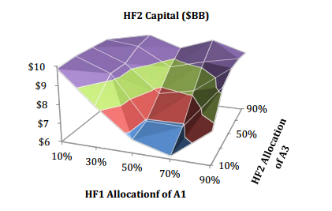


Slide 2
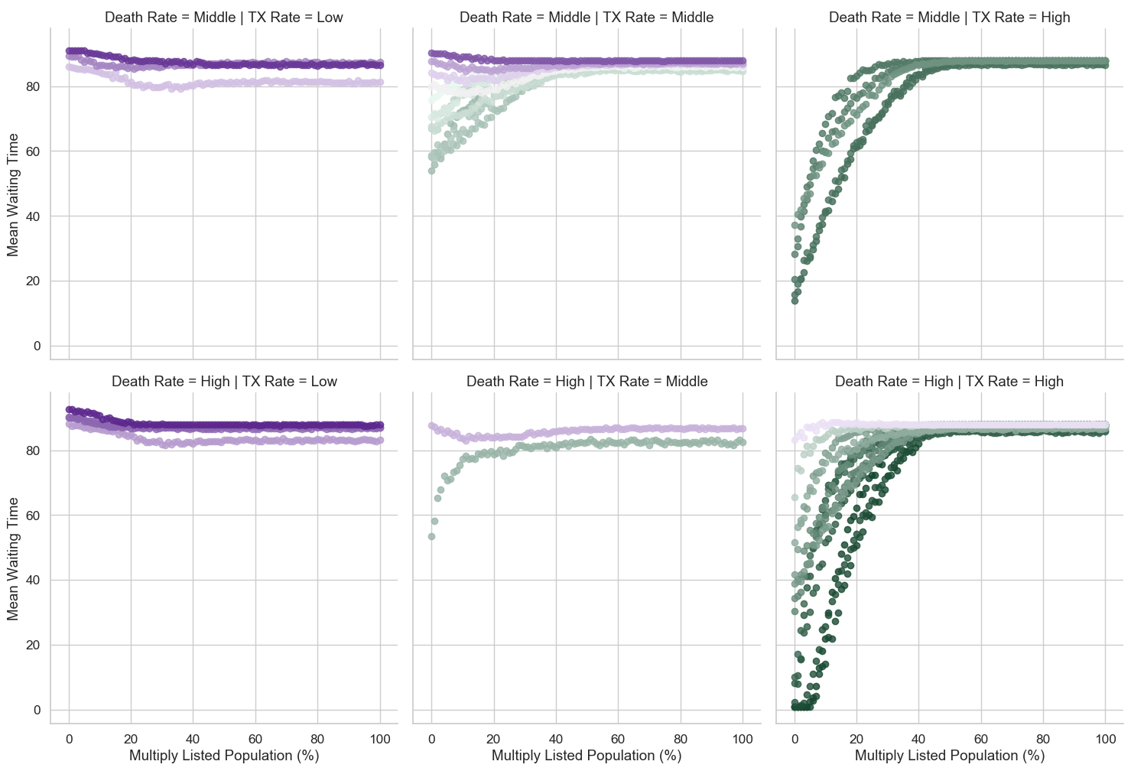
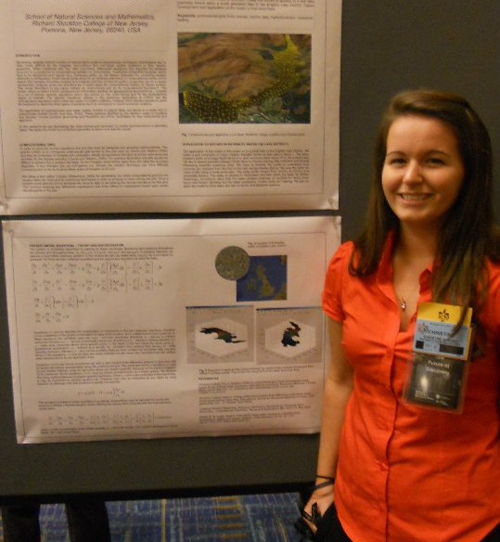
transplant2mongo
Modeling Multiple Listings in the Transplant System

Slide 3
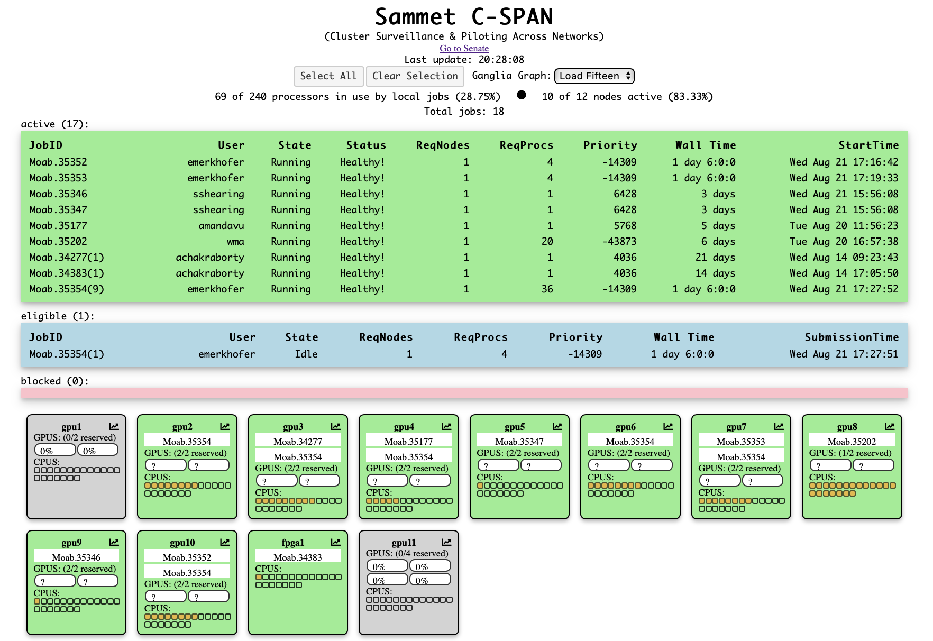
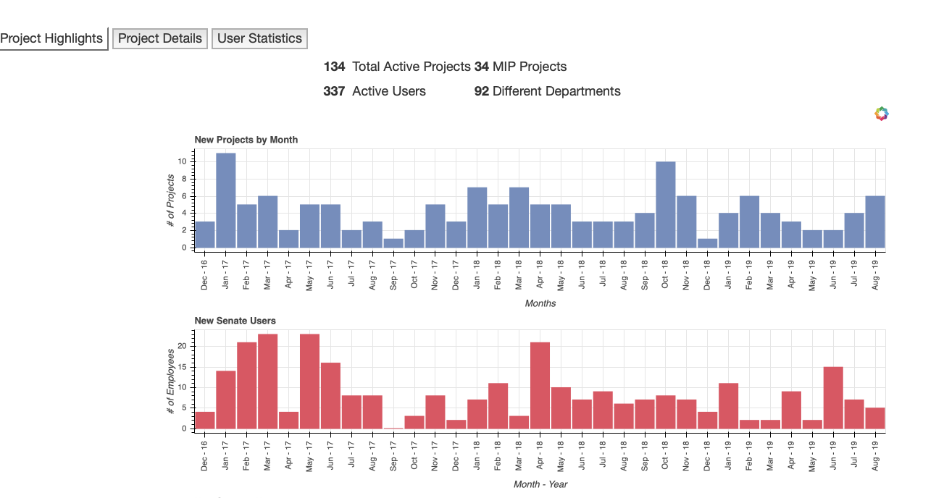
transplant2mongo
richard
tony
alaina
Modeling Multiple Listings in the Transplant System
juliana
ernesto
nathan
jaelin
danielle
danielle

